Slide 1
Information Retrieval
POLICY MAKERS GPT
GROUP 56
Kajol Dwivedi
Riya Dhama
Arpan Kumar
Atharv Srivastava
Daksh Pandey
Tony Thomas

Slide 2

Problem Statement
Policymakers need to assess the impact of their policy on vulnerable populations because understanding the impact of policies is crucial for determining whether they effectively support vulnerable groups or exacerbate their challenges.

Slide 3


Motivation
Many policies lack adequate evaluation of impacts on marginalized groups. This oversight risks exacerbating disparities and challenges.
Our chatbot bridges this crucial gap in policy assessment. Collecting data on initiatives and understanding implementation.
Analyzing effects on vulnerable populations through conversational interactions. Empowering equitable, informed policymaking to support marginalized communities.

Slide 4



Literature Review
Context-based News Articles Retrieval using CLSM https://ieeexplore.ieee.org/stamp/stamp.jsp?tp=&arnumber=9418018&tag=1
A Government Decision Analytics Framework Based on Citizen Opinion
https://dl.acm.org/doi/10.1145/2910019.2910093
Policy Impact and Evaluation
Paper:https://egyankosh.ac.in/bitstream/123456789/19391/1/Unit-27.pdf
The application of artificial intelligence in health policy: a scoping review
Paper:https://bmchealthservres.biomedcentral.com/articles/10.1186/s12913-023-10462-2

Slide 5
Proposed Solution
We have developed a chatbot to address our problem statement; we have collected data on government initiatives and user reviews from social media platforms like X and Reddit to evaluate the policy impact on vulnerable communities, empowering policymakers to make informed decisions.
Our chatbot collects data on government initiatives, assesses their impact on vulnerable communities, and provides insights to empower policymakers. By analyzing data from diverse sources, it enables informed decision-making, resource allocation, and policy prioritization for positive societal impact.

Slide 6
Novelty
There is no existing technology that focuses on analyzing user reviews from various social media platforms and putting them together for policymakers to analyze the impact of their policies.
There are surveys and feedback forms, but they are quite scattered and don’t include vulnerable populations for surveying..

Slide 7
Methodology
Data Setup:
Organize government scheme data in JSON and CSV formats.
Establish API modules for retrieving relevant tweets from platforms like Reddit and X.
2. User Query Handling:
Detect keywords from user queries.
Collect related tweets and Reddit posts, storing them in tweets.csv and reddit_posts.csv.
Conduct sentiment analysis (positive/negative) and keyword extraction.
Perform TF-IDF analysis and composite similarity ranking.
Consider metrics like favorites count and follower count.
3. Response Generation:
Using a RAG-based chatbot to generate tailored responses based on the collected information.

Slide 8
Database
Website Inspection:
Visited https://www.myscheme.gov.in/ to understand its structure and content.
Identified state-wise categorization of schemes with respective URLs.
2. Data Collection:
Conducted state-wise inspection to gather scheme data.
Copied raw HTML data including scheme names and URLs for each state.
3. Data Scraping:
Utilized BeautifulSoup Python library for web scraping.
Extracted scheme details (name, description, eligibility, benefits, application process) from scheme URLs.
4. Data Compilation:
Organized scraped data into a structured format.
Generated a JSON file for storing compiled data, ensuring accessibility and future analysis.

Slide 9
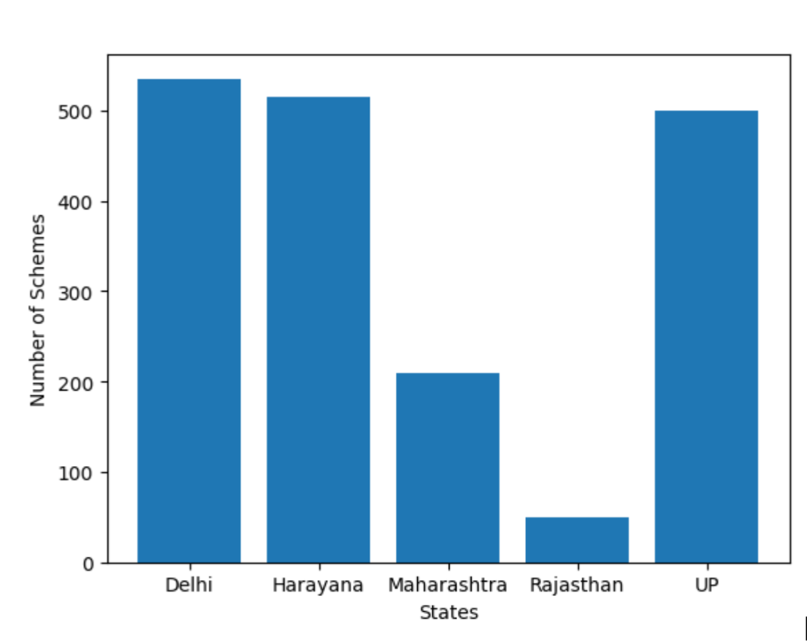
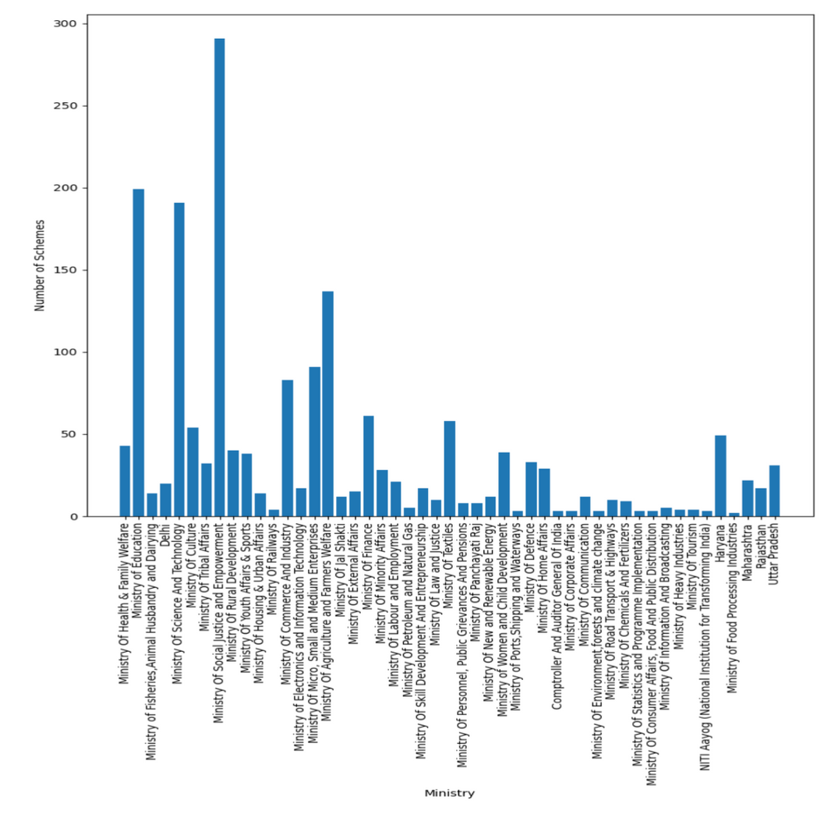
Data Analysis for Government Schemes
Graph of Number of Schemes vs State
Graph of Number of Schemes vs Ministry

Slide 10
Retrieval of Tweets and Reddit Posts
Search Terms and Policy Name Variations:
Use scheme names as search terms for X and Reddit posts.
Generate variations of policy names to improve search results, removing abbreviations or adjusting word order.
Apify Client Initialization and Actors:
Utilize Apify Client for retrieving tweets and Reddit posts.
Initialize Apify client with User Token and access "microworlds/twitter-scraper" for tweets and "trudax/reddit-scraper" for Reddit posts.
Run actors for each policy name variant, collect data, preprocess, and save as CSV files.
X Search:
Configure search parameters using a dictionary (e.g., maximum tweets, user info inclusion).
Call Apify actor for X web scraping.
Process retrieved tweets, extract relevant information, and save as "raw_tweets.csv".
Reddit Posts Search:
Set up configuration parameters for Reddit post scraping.
Call Apify client with the "trudax/reddit-scraper" actor and configured input parameters.
Process retrieved Reddit posts, extract relevant data, and save as "raw_reddit_posts.csv".

Slide 11
Sentiment Analysis
Preprocessing Text Data:
Custom function for text preprocessing:
Lowercasing text.
Tokenization (splitting into words or tokens).
Removing punctuation marks.
Removing stop words.
Stemming words to their root form.
Lemmatization to reduce words to their base form.
Sentiment Analysis Methods:
TextBlob:
Custom function to assign positive sentiment for polarity score > 0 and negative sentiment for score < 0.
Transformers Pipeline:
Custom function using a pre-trained transformer model for sentiment analysis, determining sentiment as 'POSITIVE' or 'NEGATIVE' based on a majority vote.
Roberta-base-go-emotions:
Inputting full text of tweets and Reddit posts to the model.
Performing multi-class classification with 28 emotions.
Saving results in CSV and pickle formats.

Slide 12
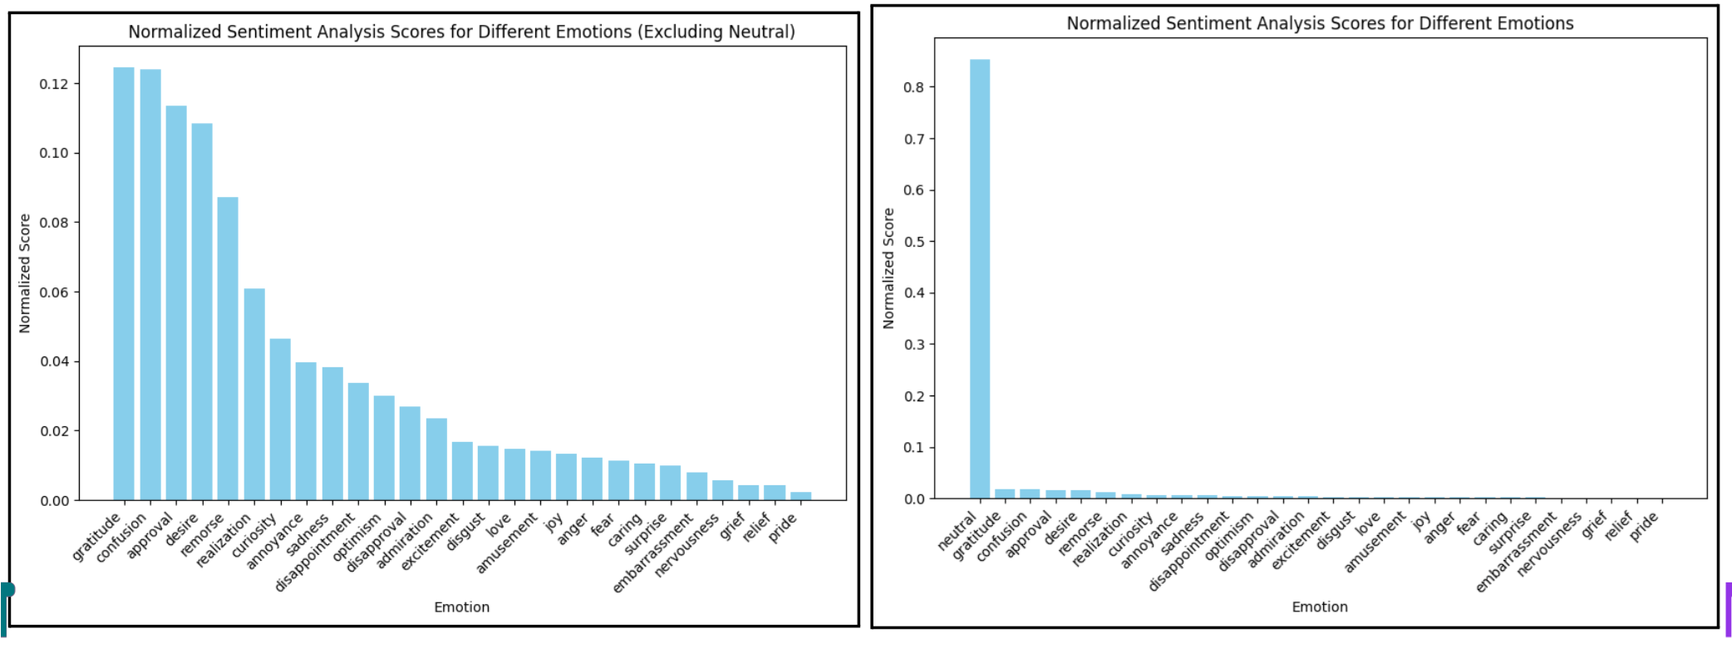
For Reddit Posts

Slide 13
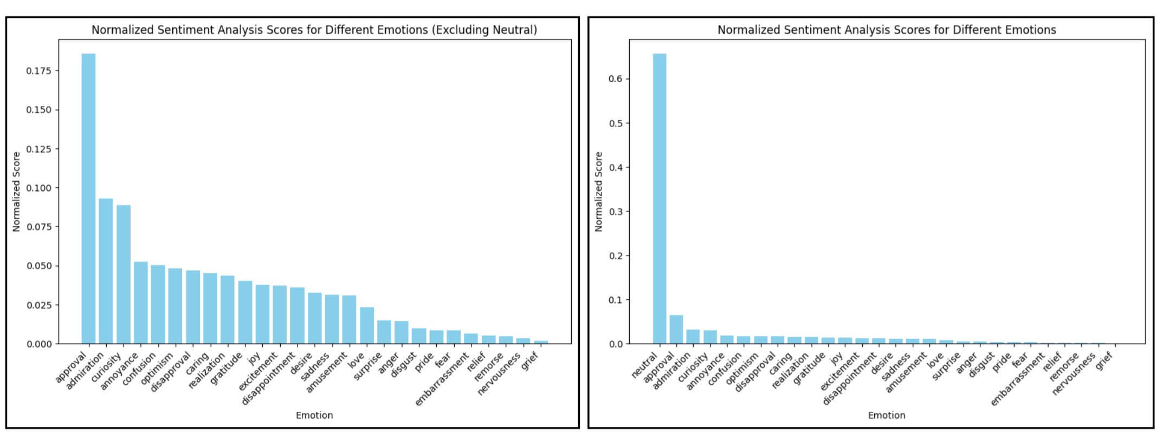
For X Posts

Slide 14
User Query Handling Process
1. Receiving User Query:
- The system receives user queries from the UI, such as: "Could you provide more details about the Ramalingaswami Re-Entry Fellowship program?"
2. Identifying Pertinent Keywords:
- The system identifies pertinent keywords or search terms from the queries.
- Example: "Tell me more about the Ramalingaswami Re-Entry Fellowship program?"
3. Data Collection:
- The system systematically scores through available tweets and Reddit posts related to the query, aggregating them into distinct files:
- Tweets.csv
- Reddit_posts.csv
4. Sentiment Analysis:
- Conduct sentiment analysis on the textual content of gathered resources to categorize them as:
- Positive or negative reviews
- Reliable or fake reviews

Slide 15
5. Keyword Extraction:
- Perform keyword extraction to ascertain the presence of rare vocabulary within the corpus.
6. Term Frequency-Inverse Document Frequency (tf-idf) Analysis:
- Execute tf-idf analysis on the dataset.
7. Leveraging Composite Similarity:
- Rank the most relevant results using composite similarity, which includes: Favorites count, Followers count, etc.
8. Relaying Information to RAG System Chatbot:
- The collated information is seamlessly relayed to the RAG system chatbot, which adeptly formulates an appropriate response tailored to address the user's query.

Slide 16
User Interface
User Interface:
Input box for user queries.
Outputs displayed as responses.
Built using Django (Python-based) to integrate seamlessly with the training model.
Chatbot Engine:
Utilizes the Retrieval-Augmented Generation (RAG) via LangChain.
Extensive testing with various Large Language Models (LLMs) and transformers from OpenAI and HuggingFace.
Selected Model:
Llama3 by Meta chosen as the primary LLM driving the chatbot.
Data Integration:
Sentiment-analyzed tweets and reddit posts are loaded, vectorized, and used in a retrieval chain to enhance response relevance.
Prompt Design:
A verbose prompt template provided to the LLM to ensure outputs are contextually relevant.

Slide 17
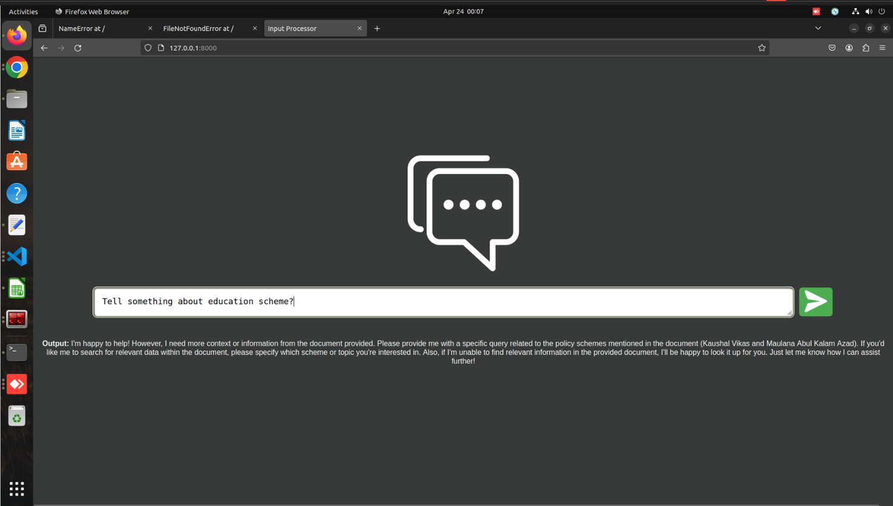
Results

Slide 18

THANK
YOU!
GROUP 56

